Slide 1

Early prediction of life-saving interventions using pre-hospital vital signs
Shiming Yang^{1,*},William Teeter^{1,3}, Meagan Watkins¹, Douglas Floccare^{1,2}, Samuel Galvagno¹, David Effon¹, Rosemary Kozar¹, Neeraj Badjatia¹, Thomas Scalea¹, Peter Hu¹
¹ University of Maryland Baltimore, School of Medicine, Baltimore, USA
² Maryland Institute for Mergency Medical Services Systems, Baltimore, USA
³ Charles McC Matthias National Study Center for Trauma and EMS
*syang@som.umaryland.edu

Slide 2

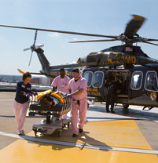
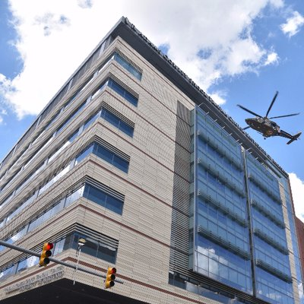
Trauma is a Race Against Time
Irreversible deterioration can happen quickly in trauma patients
Critical decisions must be made early to improve outcomes
Key questions: Can we use data collected to predict the need of critical interventions?
Goal: Develop a tool for proactive care

Slide 3
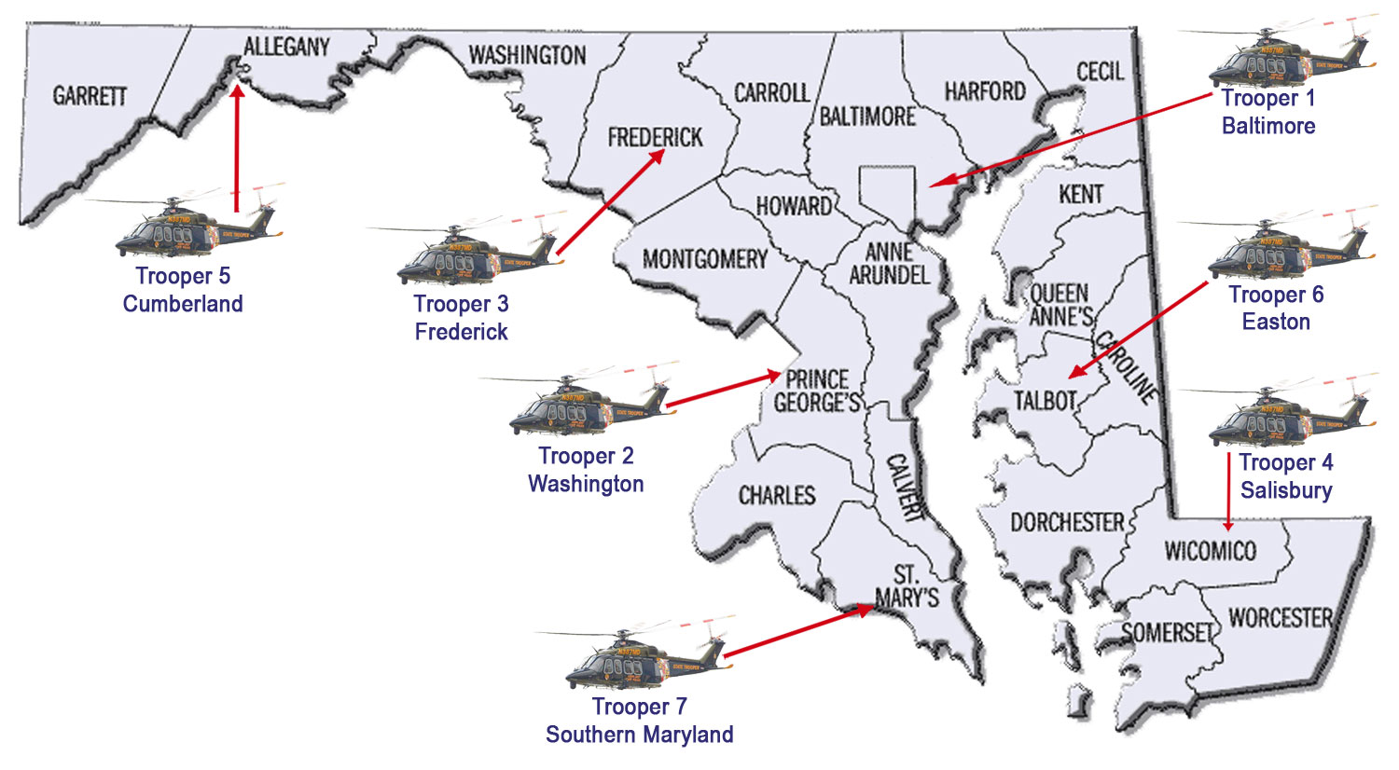
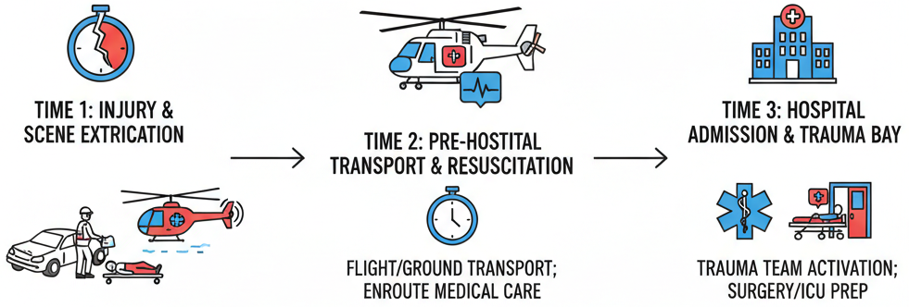
Hypothesis
Continuous pre-hospital vital signs can predict the need for life-saving interventions (LSIs)

Slide 4
Predicted LSIs
Central Line
Intubation
Transfusion
Airway Management (AM) - 17.9%
Securing the oxygen pathway
Intubation, ventilation, Oral/Nasal airway, direct laryngoscopy, etc.
Blood Product (BP) - 10.0%
Anticipating Massive hemorrhage
Transfusions (Packed red blood cells, FFP, Platelet, whole blood)
Damage Control (DC) - 5.1%
Activating the operating room
Thoracotomy, laparotomy
Vascular Access/monitoring (VC) - 8.2%
Enabling precision resuscitation
Central lines, arterial lines, external jugular, IO

Slide 5
Study population
3,000 trauma patients (2016-2018)
Trained on 1,972 in-hospital cases (inital 15 minutes)
Tested on 1,028 pre-hospital cases (helicopter transport)
 | All (N=3000) | Air (N=1028) | Land (N=1972)
AGE Mean(SD) | 38.69(13.7) | 39.81(14.23) | 38.10(13.63)
Sex Male N(%) | 2185(72.83%) | 722(70.23%) | 1463(74.19%)
Blunt N(%) | 2451(81.6%) | 939(91.34%) | 1512(76.67%)
Penetrating N(%) | 513(17.1%) | 72(7.0%) | 441(22.36%)
GCSTOTAL 1st, 2nd, 3rd Quartiles | 14,15,15 | 14,15,15 | 15,15,15
ISS 1st, 2nd, 3rd Quartiles | 2,5,14 | 5,9,17 | 1,5,10
MINS TO ED Mean(SD) | 57.47(20.21) | 72.05(15.86) | 49.87(17.93)
LOS Mean(SD) | 4.51(9.58) | 5.99(9.72) | 3.74(9.41)
ICUDAYS Mean(SD) | 1.65(5.59) | 2.37(6.68) | 1.28(4.89)
mortality N(%) | 91(3.03%) | 40(3.89%) | 51(2.59%)

Slide 6
Predictive Variables
PPG
ECG
Oximetry values
Blood pressure
Vital Sign Data:
Photoplethysmographic (PPG) waveforms
Electrocardiographic (ECG) waveforms
Blood pressure trends
Variables:
time and frequency domain features such as heart rate variability
morphological features derived from PPG and ECG
statistical variables including trends and variability measures of oximetry and blood pressure

Slide 7
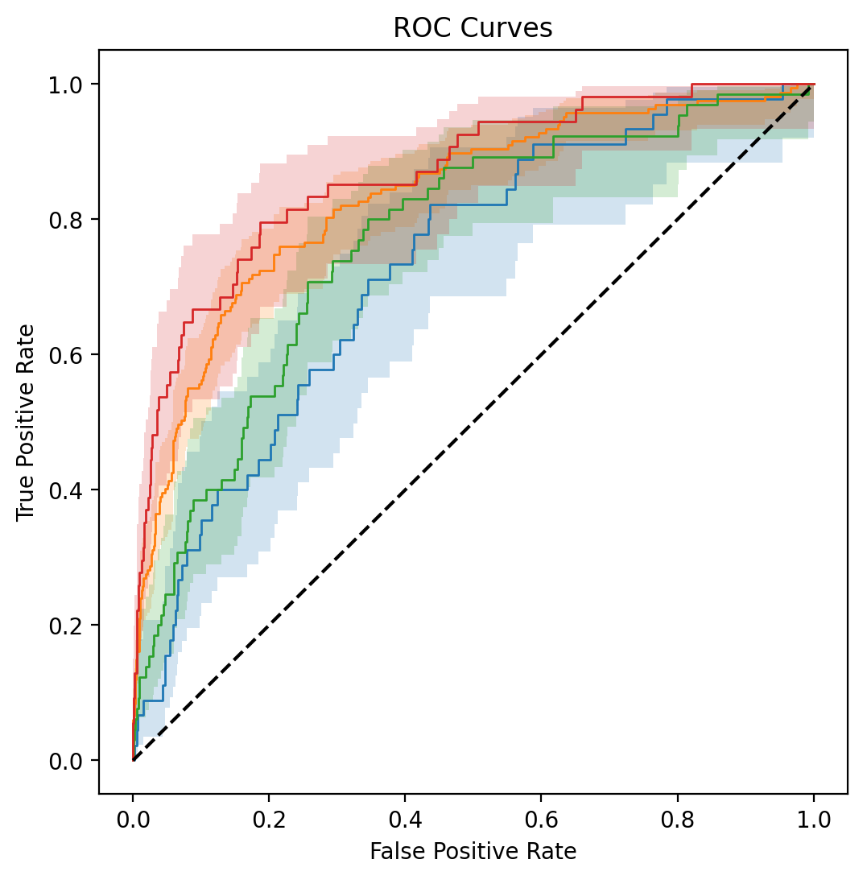
Results
Performance using pre-hospital data (AUROC [95%CI])
Airway Management (AM): 0.73 (0.66-0.80)
Blood Product (BP): 0.83 (0.80-0.87)
Damage Control (DC): 0.77 (0.71-0.83)
Vascular Access/Monitoring (VC): 0.87 (0.81-0.92)
Notes:
"The strongest prediction was for Blood Products (0.83), which is crucial as hemorrhage is the most common preventable killer."
"Even a moderate prediction for Airway (0.71) is vitally important because it gives the team time to prepare for a high-risk procedure."
"Predicting Damage Control surgery and Vascular Access allows us to mobilize the right resources and monitor the patient with the highest precision from the moment they arrive."

Slide 8
Conclusion
Continuous pre-hospital vital signs provide early prediction of LSIs.
This acts as a real-time clinical decision support tool.
Potential Impact:
Anticipate needs for hemorrhage control, airway management, and surgery.
Reduce time-to-intervention by preparing teams in advance.
Optimize resource allocation in the trauma bay.
Improve survival by preventing irreversible deterioration.

Slide 9
Future work
Integrate these models into point-of-care decision support systems.
Enhance early resuscitation protocols.
Validate in broader settings.

